Slide 1


Self-check 4
Unit check 4
UNIT 4

Slide 2

How much vocabulary do you remember?
Play this game and find out.
https://wordwall.net/play/851/279/619

Slide 3
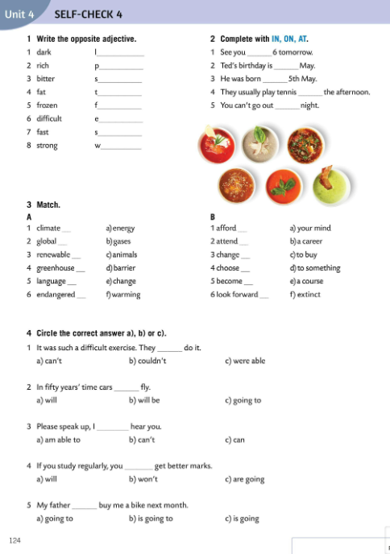
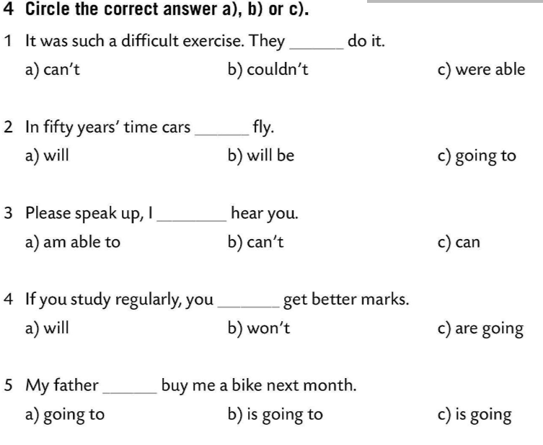
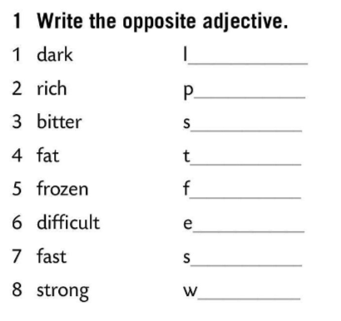
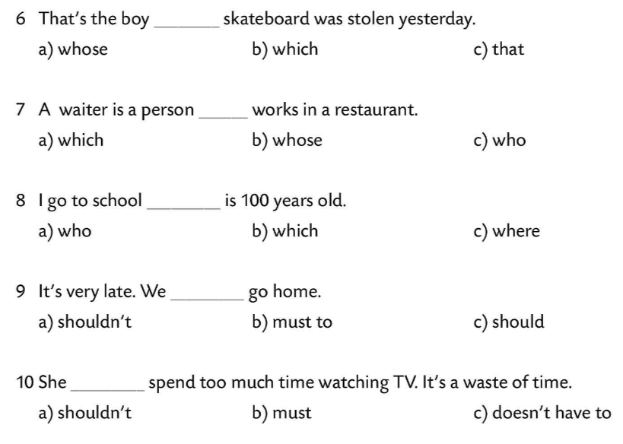
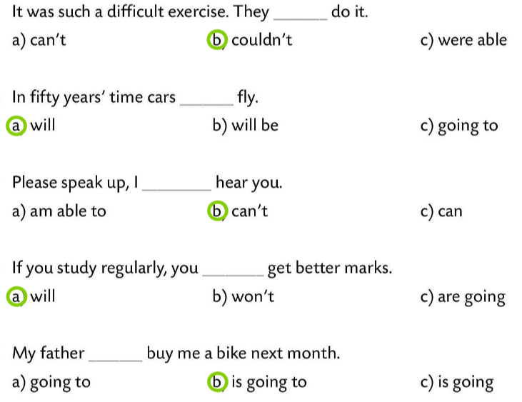
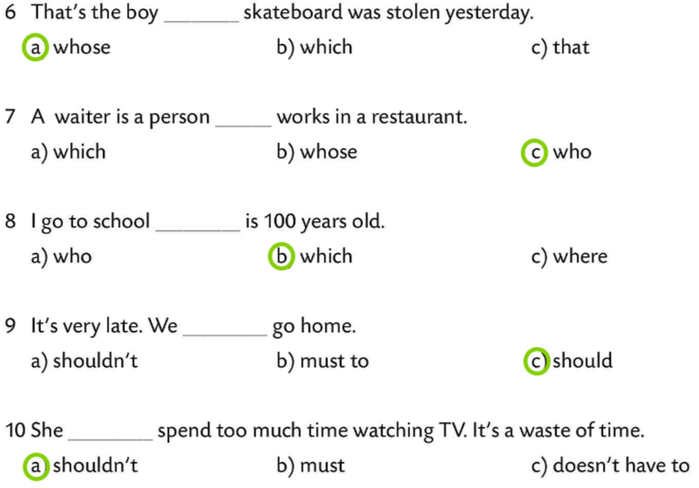
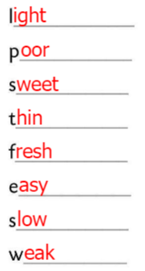
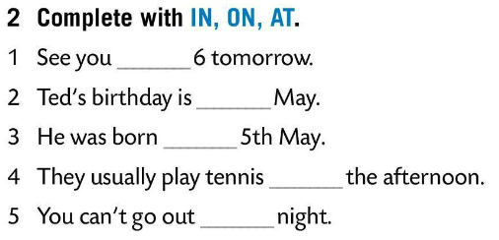
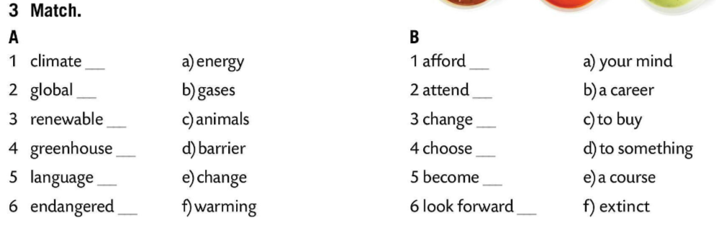
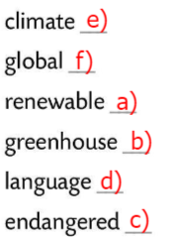
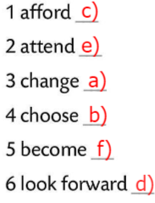
Write the opposite adjective.
Check.
Complete with IN, ON, AT.
at
in
Check.
on
in
Match.
at
Check.
Circle the correct answer.
Check.

Slide 4
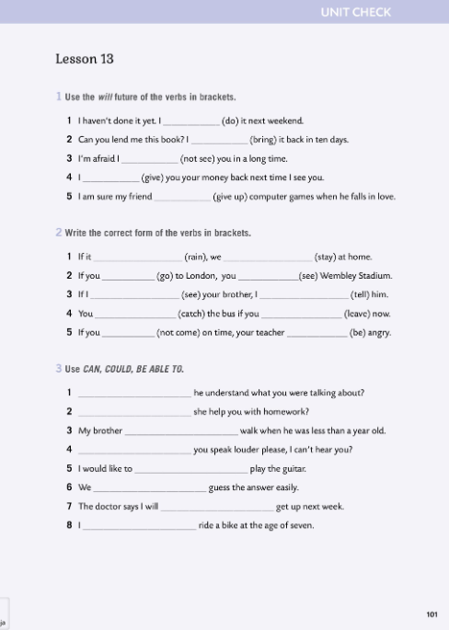

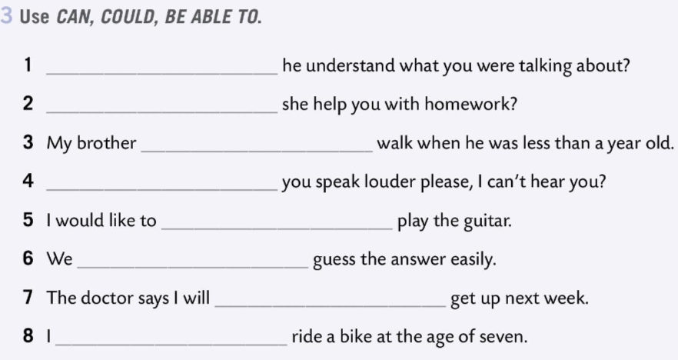
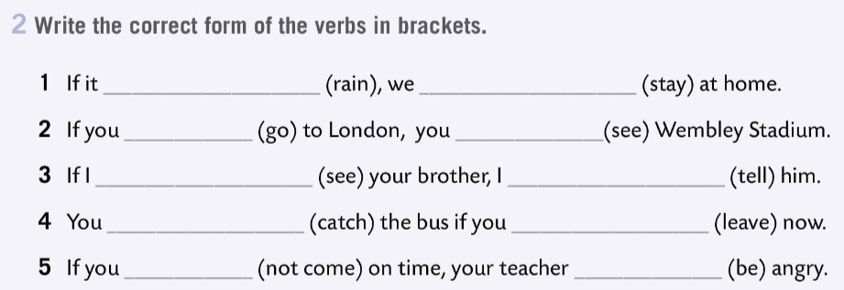
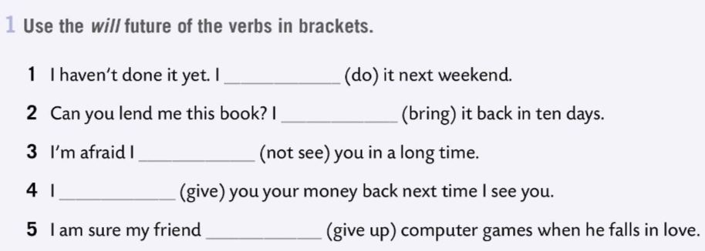
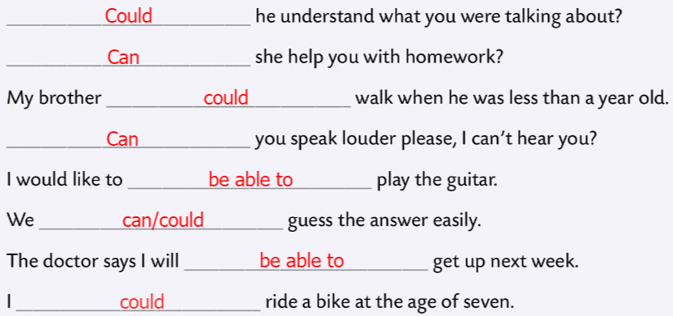
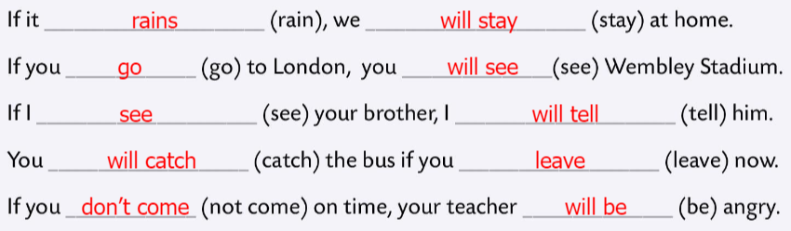
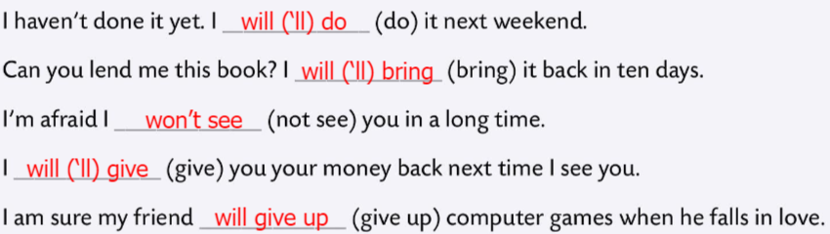
Workbook, page 101 UNIT CHECK 4
Use the will future of the verbs in brackets.
Check.
Write the correct form of the verbs in brackets.
Check.
Use CAN, COULD, BE ABLE TO.
Check.

Slide 5
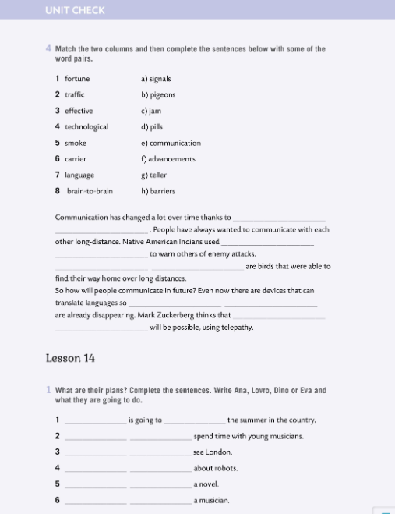
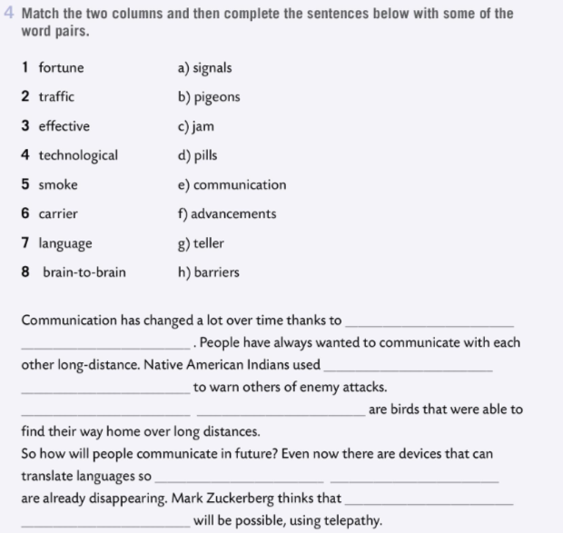
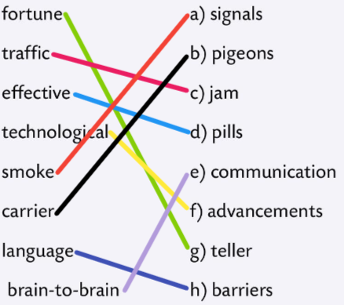
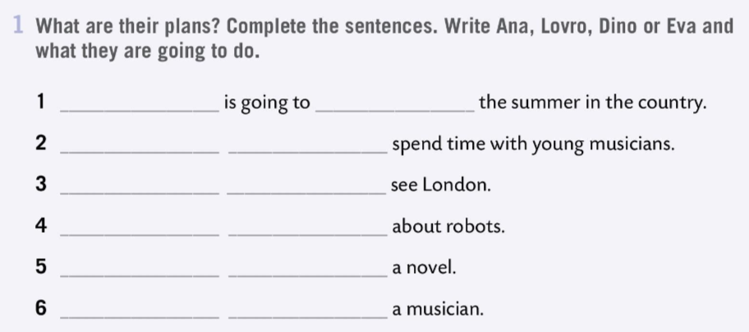
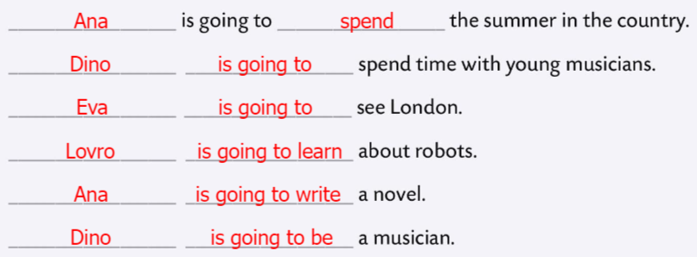
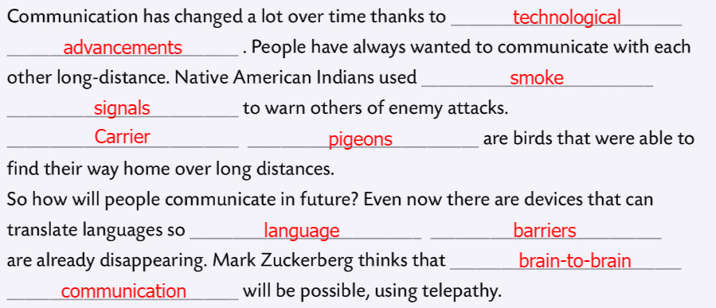
Workbook, page 102 UNIT CHECK 4
Match the two columns. Complete the sentences below with some of the word pairs.
Check.
What are their plans? Complete the sentences. Write Ana, Lovro, Dino or Eva and what they are going to do.
Check.

Slide 6
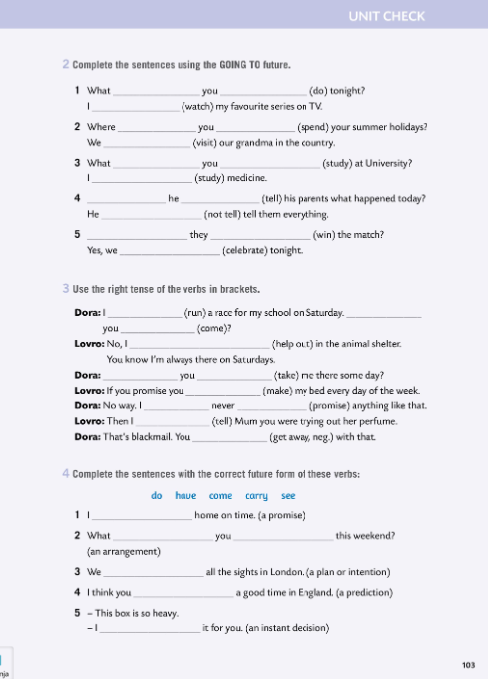
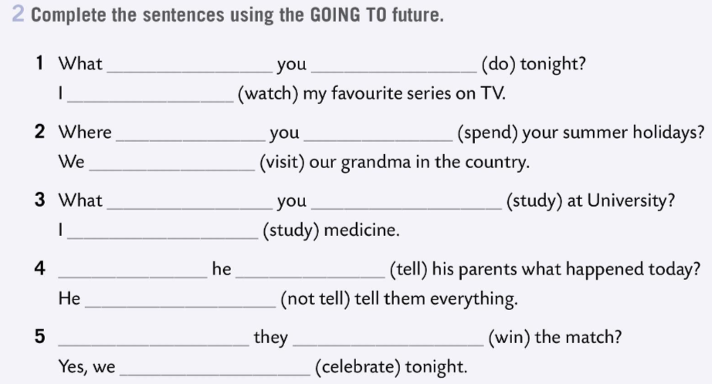
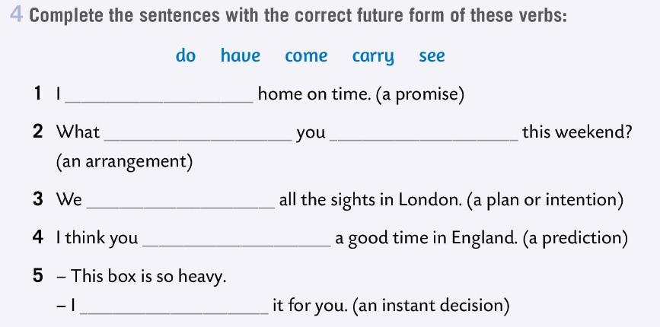
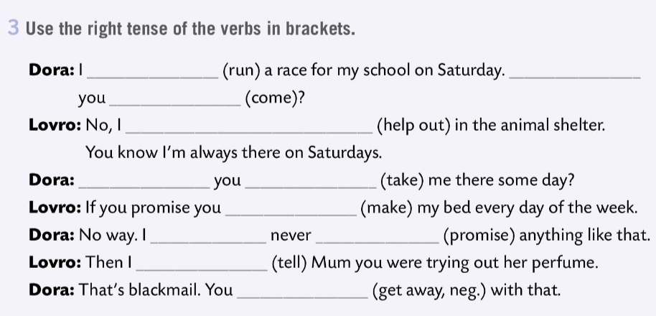
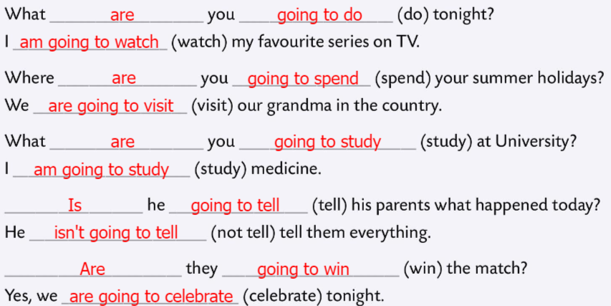
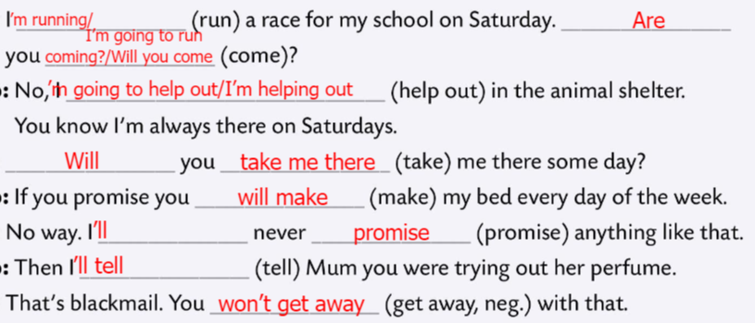
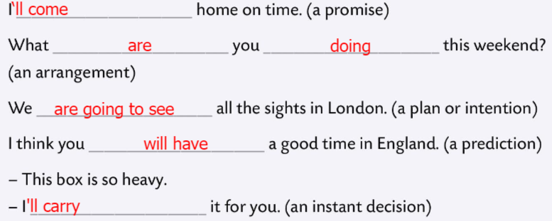
Workbook, page 103 UNIT CHECK 4
Complete the sentences using the GOING TO future.
Check.
Use the right tense of the verbs in brackets.
Check.
Complete the sentences with the correct future form of verbs in Task 4.
Check.

Slide 7
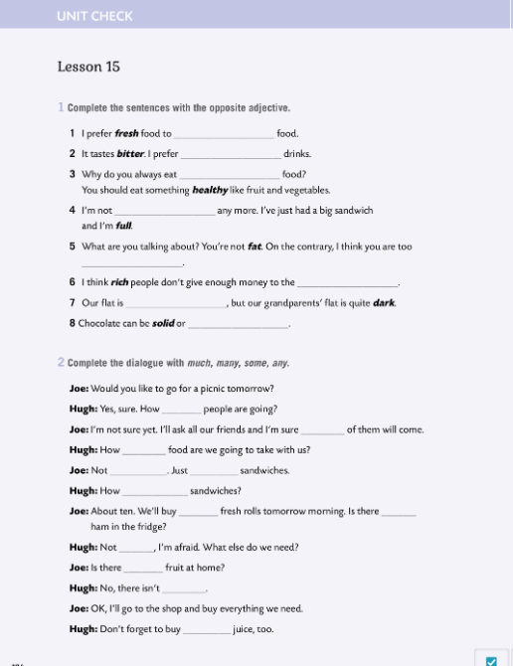
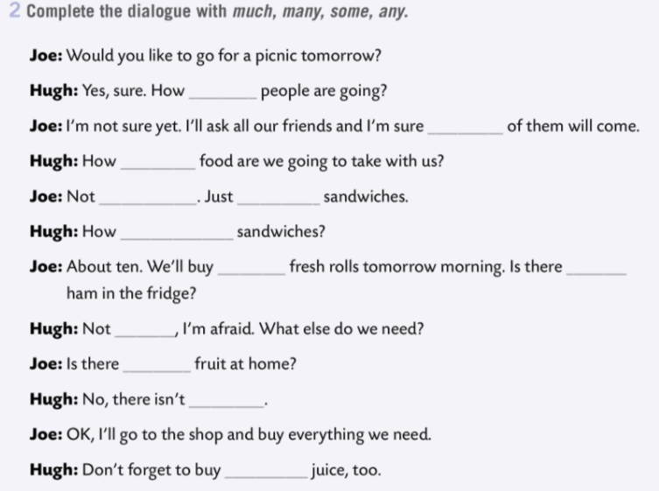
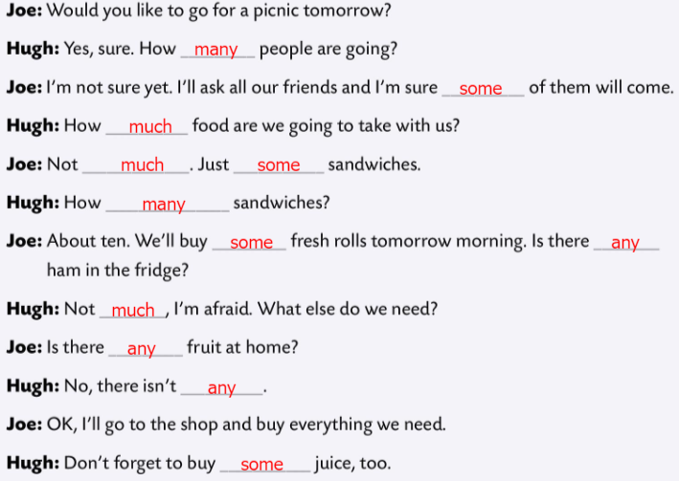
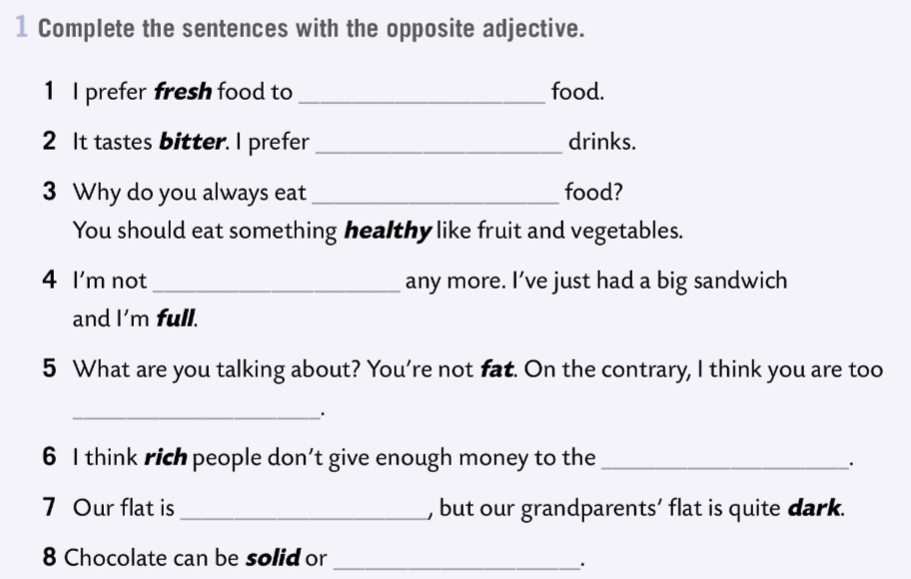
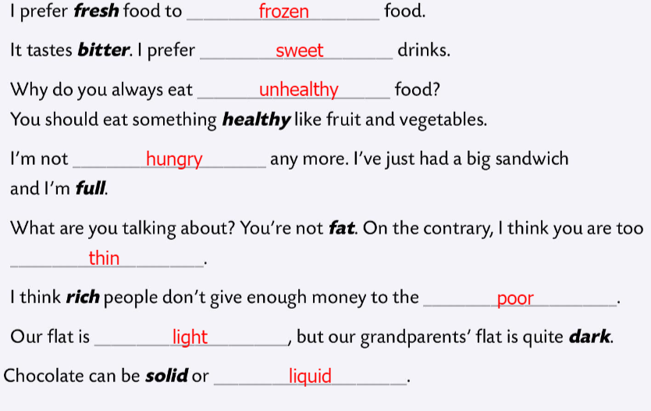
Workbook, page 104 UNIT CHECK 4
Complete the sentences with the opposite adjective.
Check.
Complete the dialogue with much, many , some, any.
Check.

Slide 8
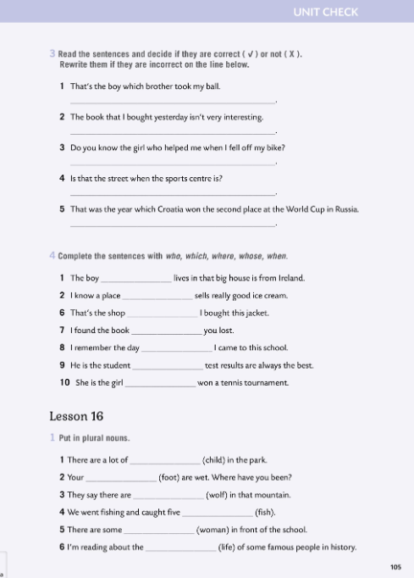
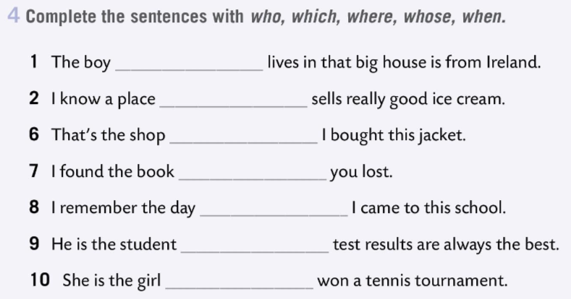
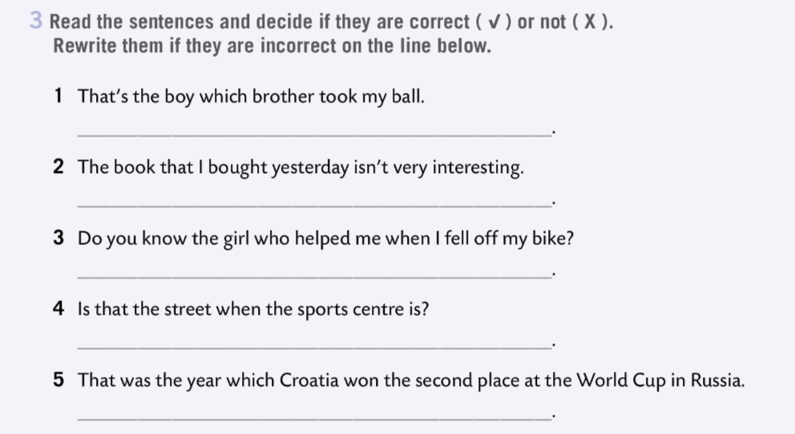
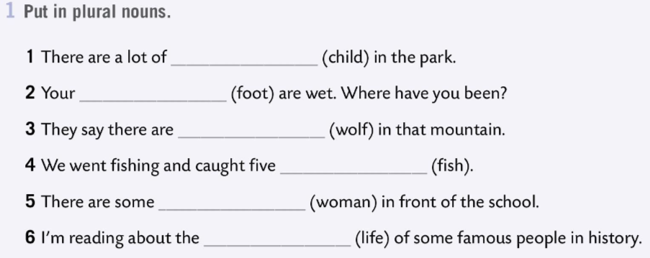
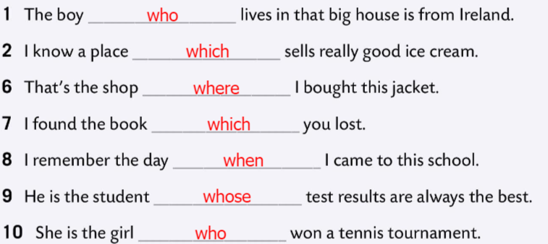
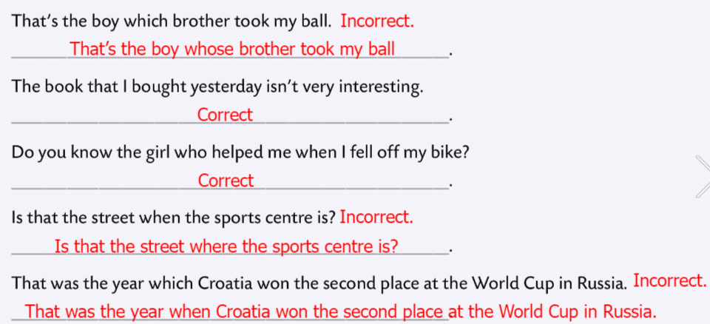
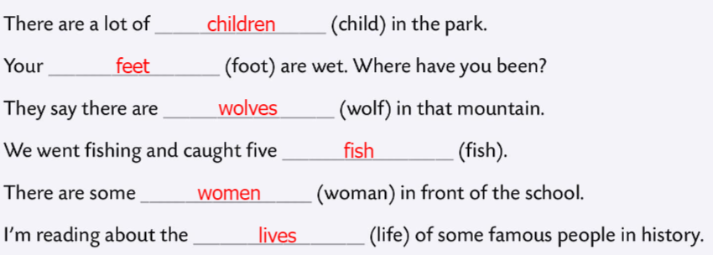
Workbook, page 105 UNIT CHECK 4
Read the sentences and decide if they are correct or not.
Rewrite them if they are incorrect.
Check.
Complete the sentences with who, which, where, whose and when.
Check.
Put in plural nouns.
Check.

Slide 9
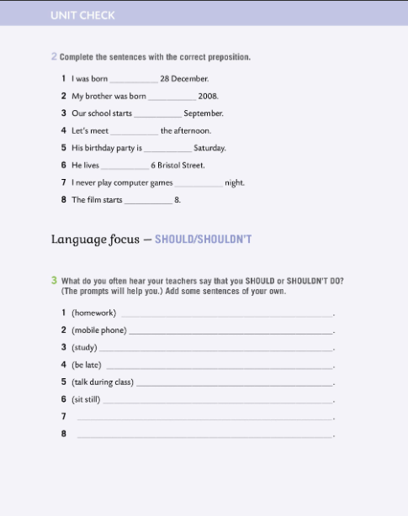
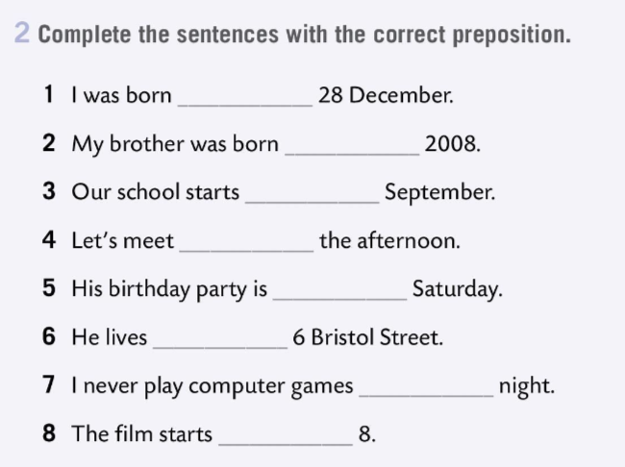
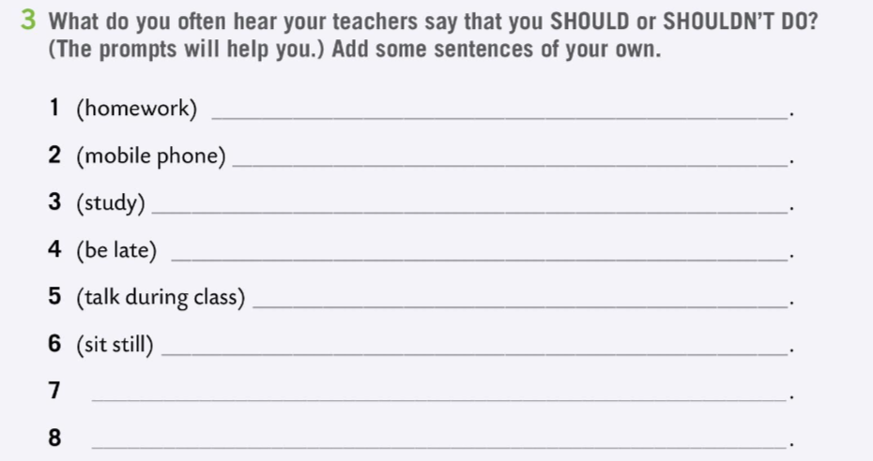
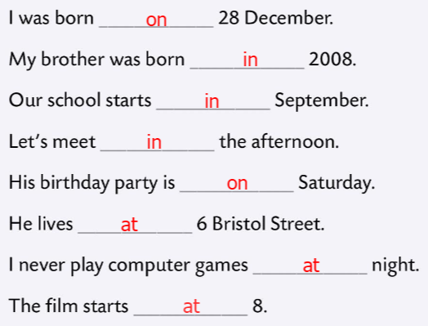
Workbook, page 106 UNIT CHECK 4
Complete the sentences with the correct preposition.
Check.
What do you often hear your teachers say that you SHOULD or SHOULDN’T DO? (The prompts will help you.) Add some sentences of your own.
Check in class.

Slide 10
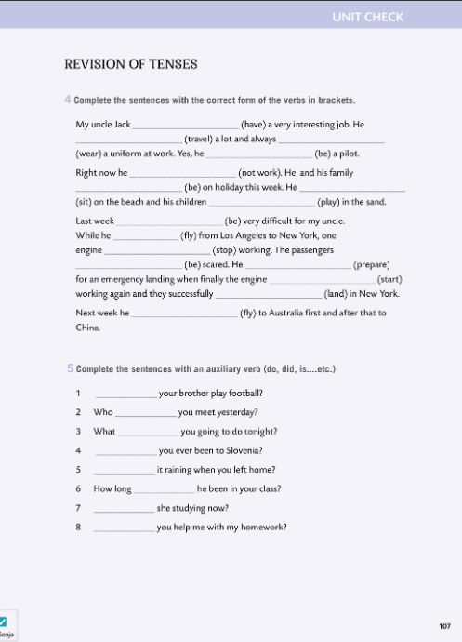
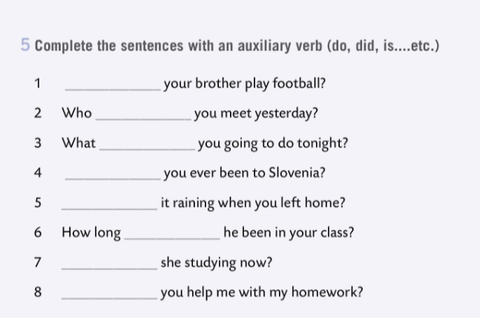
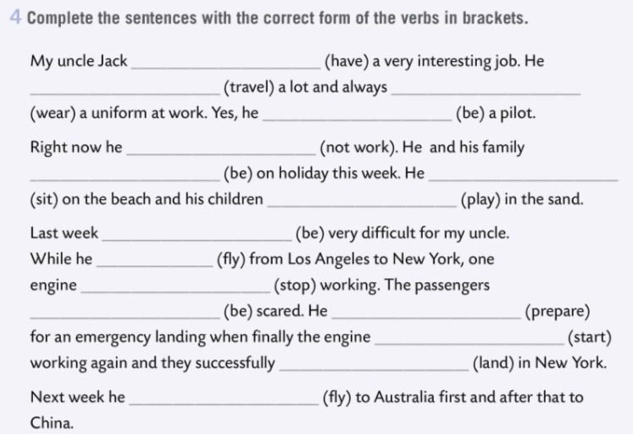


Workbook, page 107 UNIT CHECK 4
Complete the sentences with the correct form of the verbs in brackets.
Check.
Complete the sentences with an auxiliary verb (do, did, is…etc.).
Check.

Slide 11


Workbook, page 108 UNIT CHECK 4
Tick all the words/expressions you can translate. Look up the others in the word list.
Mark all the adjectives with a little star * and underline all the verbs.
Find 5 words that can be used with food and drink and 5 words related with ecology.
Write down the words/expressions you’d like to remember.

Slide 12



Workbook, page 109 UNIT CHECK 4
Tick the statements that are true for you.

Slide 13


Look at the ‘I can…’ table.
Which of the outcomes did you master very well?
Which need more improvement and which need more time and practice?
Be honest and put a tick in the columns based on how well you understood this unit.

